Slide 1
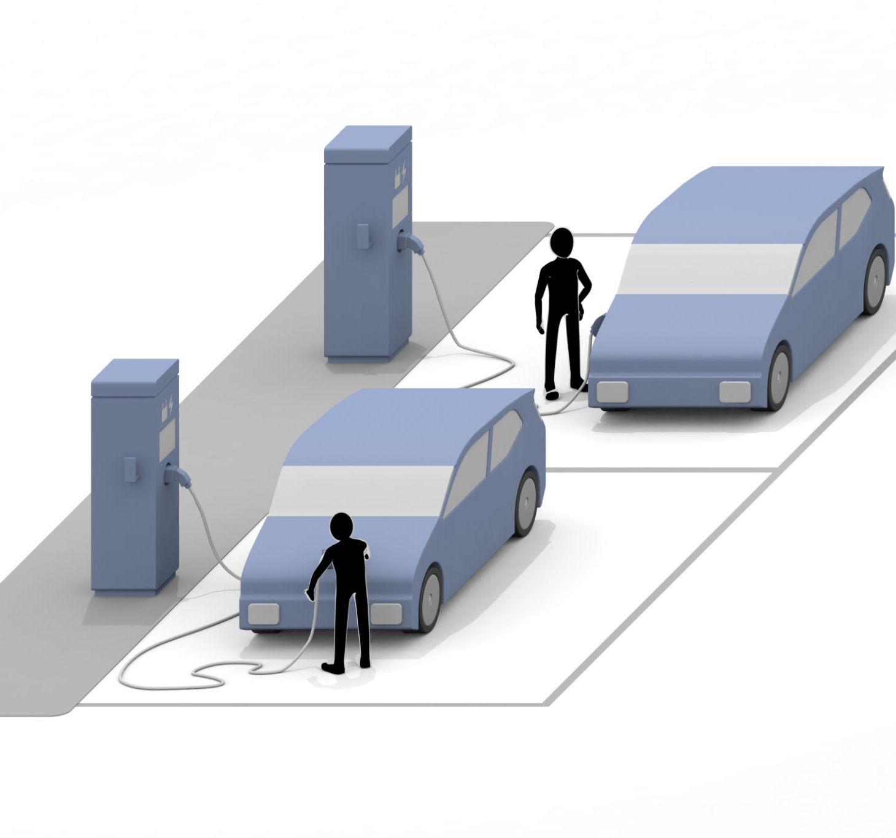
Vehicle State Estimation for Autonomous Systems
By Ali Almotazbellah

Slide 2
The Core Problem: Why is Localization Hard?
An autonomous vehicle needs to answer a fundamental question: "Where am I?

Slide 3
The Core Problem: Why is Localization Hard?
Sensor Uncertainty (Input): The world isn't always perceived perfectly.
Noise: Environmental factors (poor light, reflective surfaces).
Aliasing: Different places can look the same to sensors.
Effector Uncertainty (Action): Commands aren't always executed perfectly.
Noise: Wheel slippage, slopes, unmodeled forces.

Slide 4

Goal: Combine imperfect information to create a single, highly accurate state estimate.

Slide 5

The Sensor Suite
IMU, GNSS/GPS, LIDAR

Slide 6
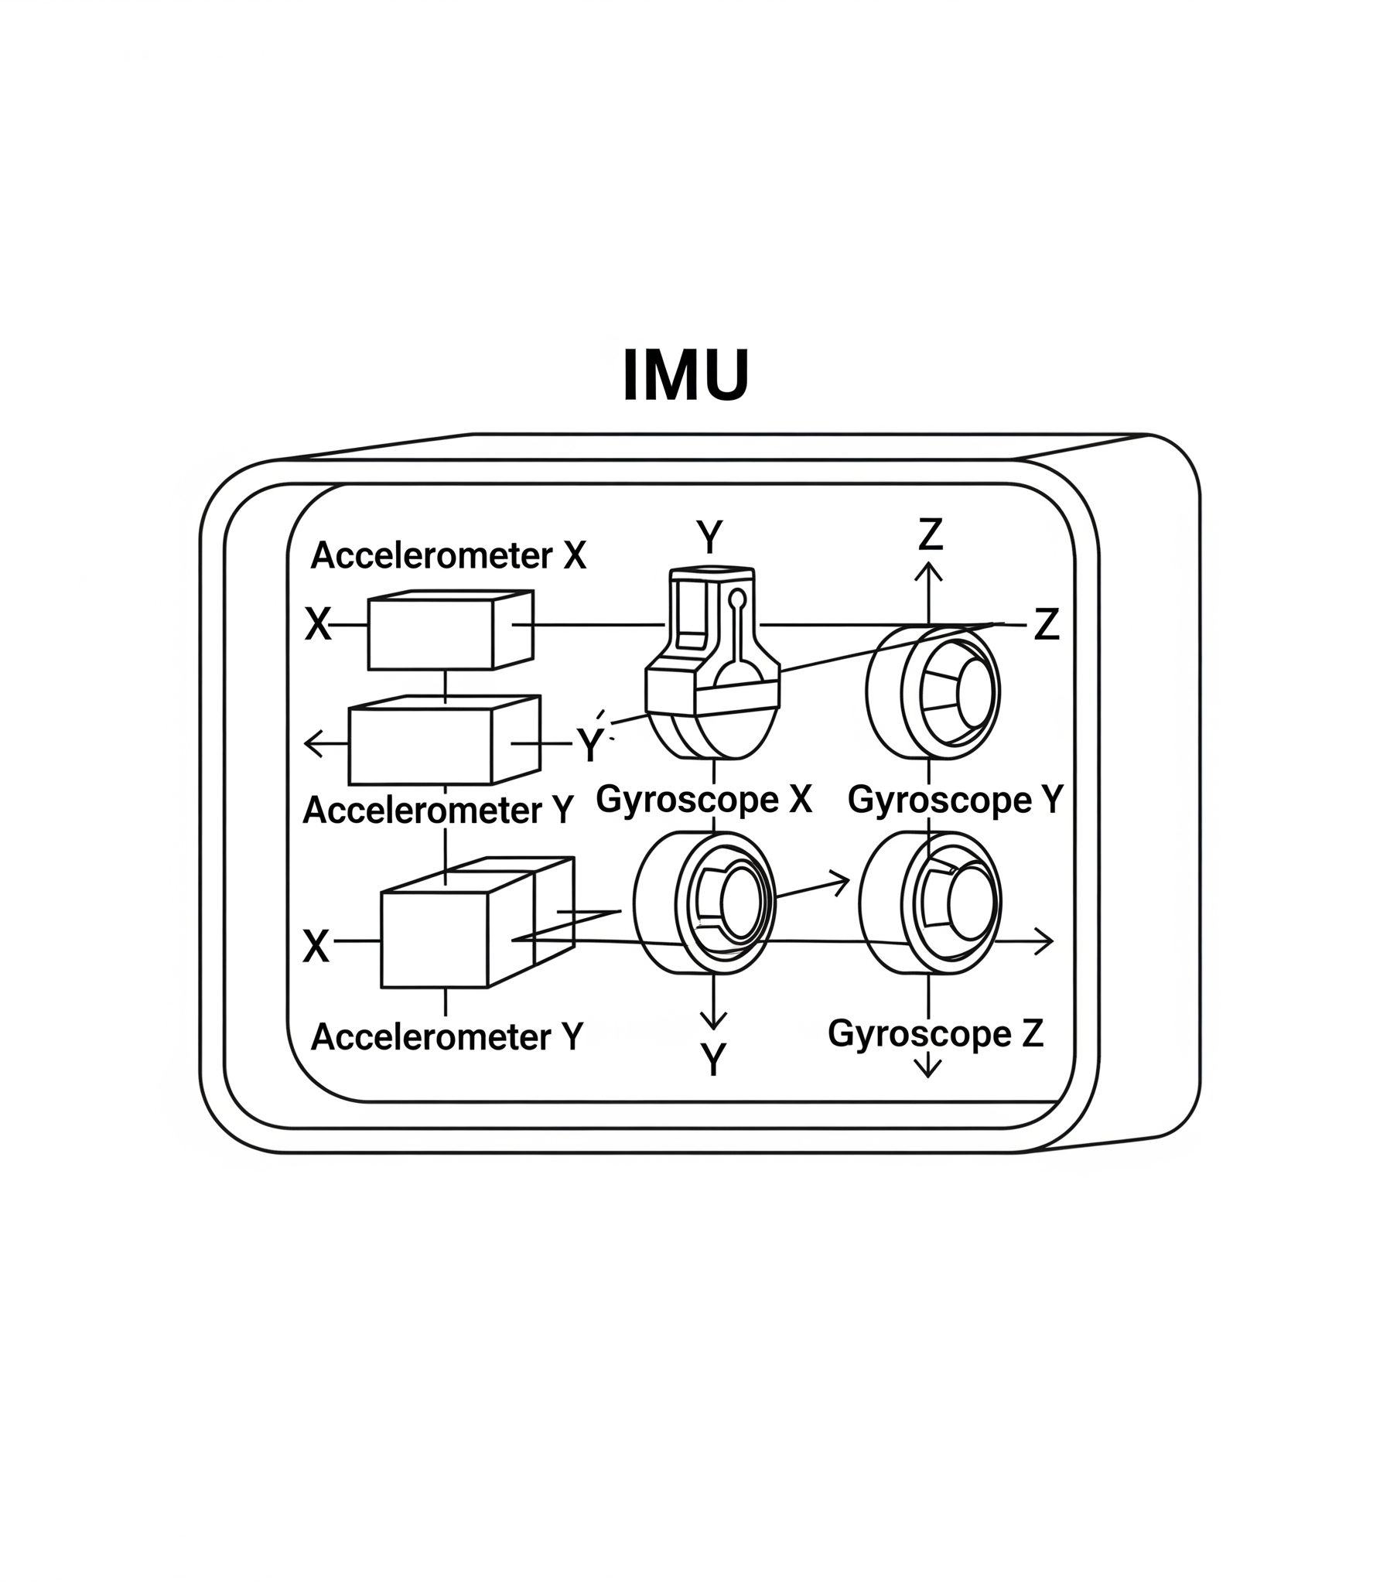
Inertial Measurement Unit (IMU)
Measures:
Angular Velocity (ω): Gyroscopes (Roll, Pitch, Yaw)
Specific Force (f): Accelerometers (X, Y, Z)
Strength: High-frequency updates (hundreds of Hz). Excellent for tracking fast motion.
Weakness: Drift. Errors accumulate over time, leading to an unbounded position error.

Slide 7

Global Navigation Satellite System (GNSS)
Measures: Absolute Position (p) on Earth.
Principle: Trilateration from satellite signals.
Strength: No Drift. Provides a global position reference.
Weaknesses:
Low update rate (a few Hz).
Low precision (meter-level error).
Unavailable indoors, in tunnels, or "urban canyons".

Slide 8

Light Detection and Ranging (LiDAR)
Measures: Range (r), Azimuth (α), Elevation (ε).
Principle: Time-of-Flight of laser pulses.
Output: A 3D Point Cloud of the environment.
Strength: Highly accurate and dense 3D measurements.
Weakness: Can be affected by weather (rain, fog) and highly reflective surfaces.

Slide 9

The Error-State Extended Kalman Filter (ES-EKF) Loop
A recursive algorithm to optimally fuse uncertain information in a Loosely-Coupled architecture.

Slide 10
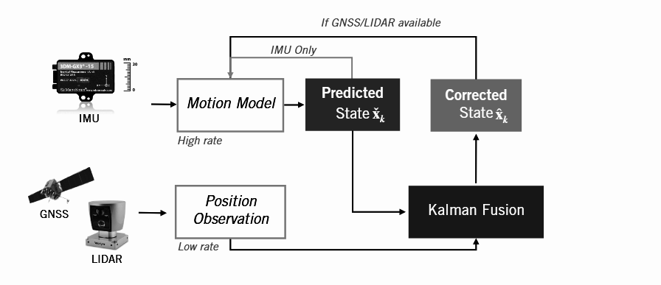

Slide 11
The ES-Extended Kalman Filter (ES-EKF) Loop
The Predict Step: Trusting the IMU (for a moment)
We use the high-frequency IMU data (f, ω) as input to our Motion Model.
This model integrates the vehicle's kinematics forward in time.
Output: A Predicted State (x̃k). This is our best guess, but we know it has accumulated drift. Uncertainty increases.

Slide 12
Update state with IMU inputs
We use kinematic equations to predict the new state (p̃k, ṽk, q̃k) from the previous state and IMU inputs (f, ω).
Position:
pk = pk-1 + Δt * vk-1 + (Δt²/2) * (Cns * fk-1 + g)
Velocity:
vk = vk-1 + Δt * (Cns * fk-1 + g)
Orientation:
qk = qk-1 ⊗ q(ωk-1 * Δt)
Orientation is represented by a unit quaternion (q) for numerical stability.
This gives us our best guess, but it includes accumulated drift.

Slide 13

Propagate uncertainty
We also linearize the motion model to propagate the uncertainty of the error state.
Covariance Prediction: P̃k = Fk-1 * Pk-1 * Fk-1^T + Lk-1 * Qk-1 * Lk-1^T

Slide 14
The ES-Extended Kalman Filter (ES-EKF) Loop
The Update Step: Correcting with GPS/LiDAR
A low-frequency, high-accuracy Position Observation (yk) arrives from GPS or a LiDAR-based motion estimate.
This measurement is fused with the Predicted State in the Kalman Fusion step.
Output: A Corrected State (x̂k). The IMU's drift is corrected, and our overall uncertainty is reduced.

Slide 15
Update Measurement from LiDAR (ICP)
To get a measurement (yk) from LiDAR, we align two point clouds using the Iterative Closest Point (ICP) algorithm.
Initial Guess: The high-rate prediction from the IMU motion model provides an excellent initial guess for the transformation, making ICP faster and more reliable.
argmin_{C, r} Σ ||(C * ps + r) - p's'||²
.

Slide 16
Update Measurement from LiDAR (ICP)
The ICP Procedure:
Get an initial guess for the transformation (from the IMU motion model).
Associate each point in the first cloud with the nearest point in the second.
Solve for the optimal transformation that minimizes the distance between associated points.
Repeat until convergence.
The resulting transform {Ĉ, r̂} is our motion measurement yk

Slide 17
ICP Math: Step 1 & 2 - Centroids & Covariance
We decouple the problem by solving for rotation first.
Compute Centroids (Center of Mass) of the associated point sets Ps and Ps':
μs = (1/n) * Σ(ps)
μs' = (1/n) * Σ(p's')
Compute Cross-Covariance Matrix of the centered points:
Wss' = (1/n) * Σ((ps - μs)(p's' - μs')^T)

Slide 18
ICP Math: Step 3 - Finding Rotation via SVD
We use Singular Value Decomposition (SVD) to factor the cross-covariance matrix W.
SVD: W = U * S * V^T
Optimal Rotation Ĉ: We combine the rotational components and discard scaling, ensuring a proper rotation.
Ĉ = U * diag(1, 1, det(U) * det(V)) * V^T

Slide 19
ICP Math: Step 4 - Finding Translation
With the optimal rotation Ĉ known, we can solve for the translation r̂.
Optimal Translation r̂: The translation is the vector that aligns the rotated centroid of the first cloud with the centroid of the second.
r̂ = μs' - Ĉ * μs
The final transform {Ĉ, r̂} is our motion measurement yk. This is a Point-to-Point ICP approach.

Slide 20
The Challenge: Outliers in a Dynamic World
What happens when the world isn't static? (e.g., a moving truck appears).
Problem:
Outliers from dynamic objects violate the static world assumption of ICP. They corrupt the centroid calculation and lead to incorrect alignment.

Slide 21
The Challenge: Outliers in a Dynamic World Solutions
Robust Loss Functions:
Use error metrics (e.g., L1 Norm, Huber) that are less sensitive to large errors.
Full Sensor Fusion (ES-EKF):
Use a probabilistic framework to weigh the LiDAR measurement against the IMU prediction based on their respective uncertainties. This is the more comprehensive approach.

Slide 22
Update Measurement from GNSS
To get a measurement (yk) from GPS/GNSS, we use the position it provides directly.
Measurement Model: A direct observation of position.
yk = pk + νk
Hk = [ I 0 0 ] (Observation matrix)
νk is the measurement noise, with covariance R_GNSS.

Slide 23
The ES-EKF Update Loop - Step 1 & 2
This is the core fusion algorithm, performed whenever a LiDAR or GNSS measurement yk is available.
Compute Kalman Gain (Kk): The gain optimally weighs the prediction uncertainty against the measurement uncertainty.
Kk = P̃k * Hk^T * (Hk * P̃k * Hk^T + R)^-1
Compute Error State (δxk): The filter estimates the error in our prediction.
δxk = Kk * (yk - p̃k)

Slide 24
The ES-EKF Update Loop - Step 3 & 4
Correct Predicted State: The error state is applied to correct the drifted prediction.
p̂k = p̃k + δpk
v̂k = ṽk + δvk
q̂k = q(δφ) ⊗ q̃k
(Correction is multiplicative for rotation ,global orientation error)
Compute Corrected Covariance (P̂k): The uncertainty is reduced.
P̂k = (I - Kk * Hk) * P̃k
The corrected state (^) becomes the input for the next prediction cycle.

Slide 25
Loop:
1. Update state with IMU inputs
2. Propagate uncertainty
3. If GNSS or LIDAR position available:
1. Compute Kalman Gain
2. Compute error state
3. Correct predicted state
4. Computed corrected covariance

Slide 26
Assumptions:
1
2
3
4
LIDAR provides positions in the same reference frame as
GNSS (possible)
IMU has no biases (not realistic!)
State initialization is provided (realistic)
Our sensors are spatially and temporally aligned
(somewhat realistic)

Slide 27
THANK YOU (UuU)

